Slide 1
MakeCode web app
Blockly
Final
Executable
JavaScript
User
Machine Code
link
Runtime
Machine Code
a priori
compile
C++ runtime

Slide 2
web app
Blockly
Final
Executable
User
Program text
compile
service
User
Program text
User
Machine Code
link
Runtime
Machine Code
a priori
compile
C++ runtime

Slide 3
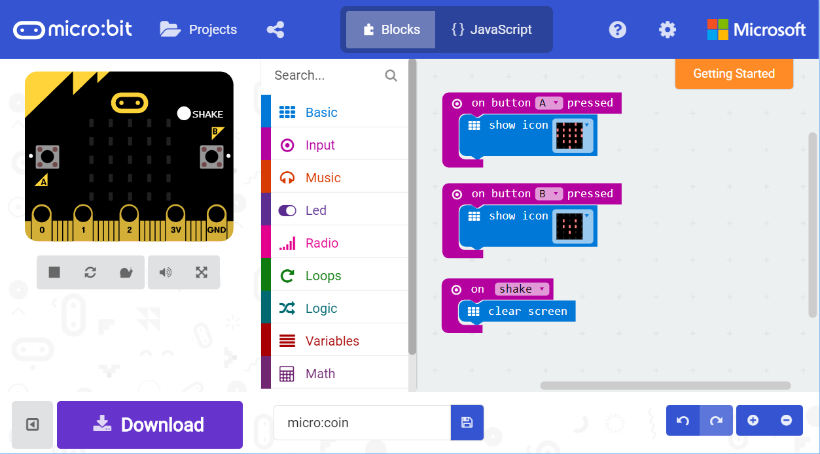
A
D
C
B
E

Slide 4
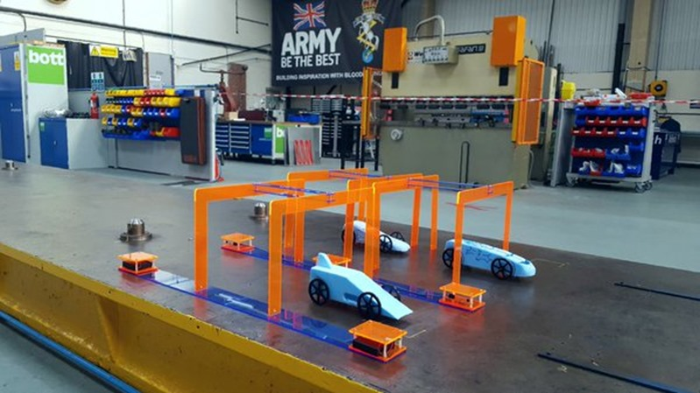
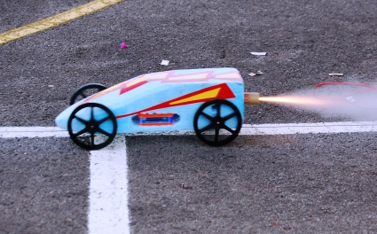
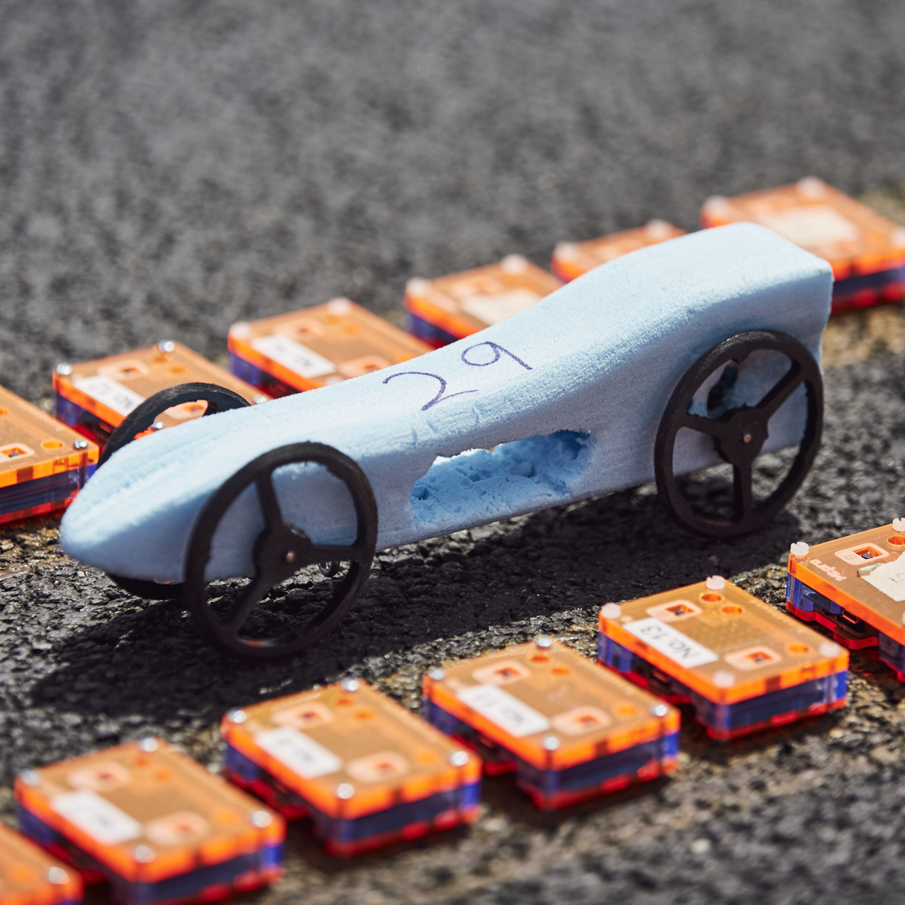
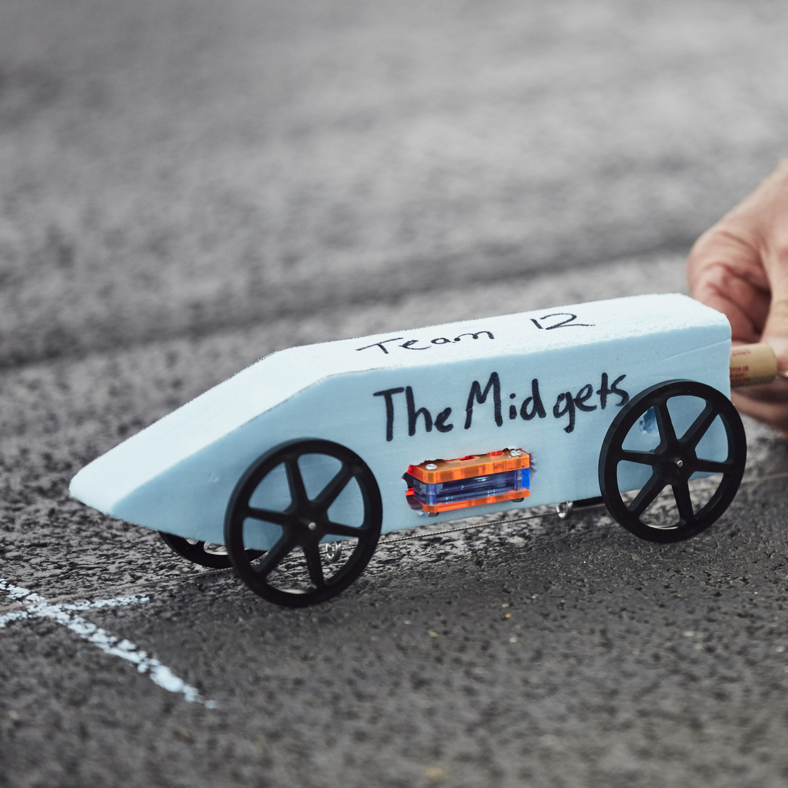
Rocket Car
Notes:
https://blogs.msdn.microsoft.com/uk_faculty_connection/2016/04/26/bloodhound-microbit-race-for-the-line-schools-competition/

Slide 5
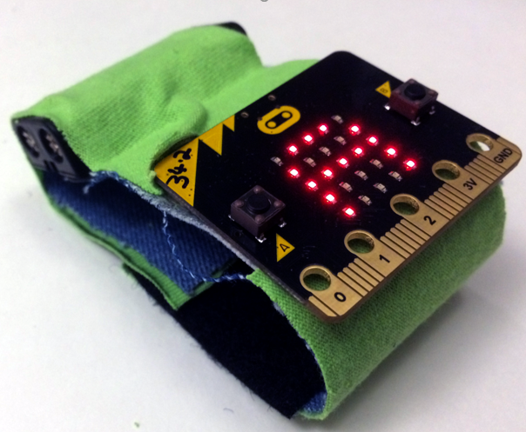
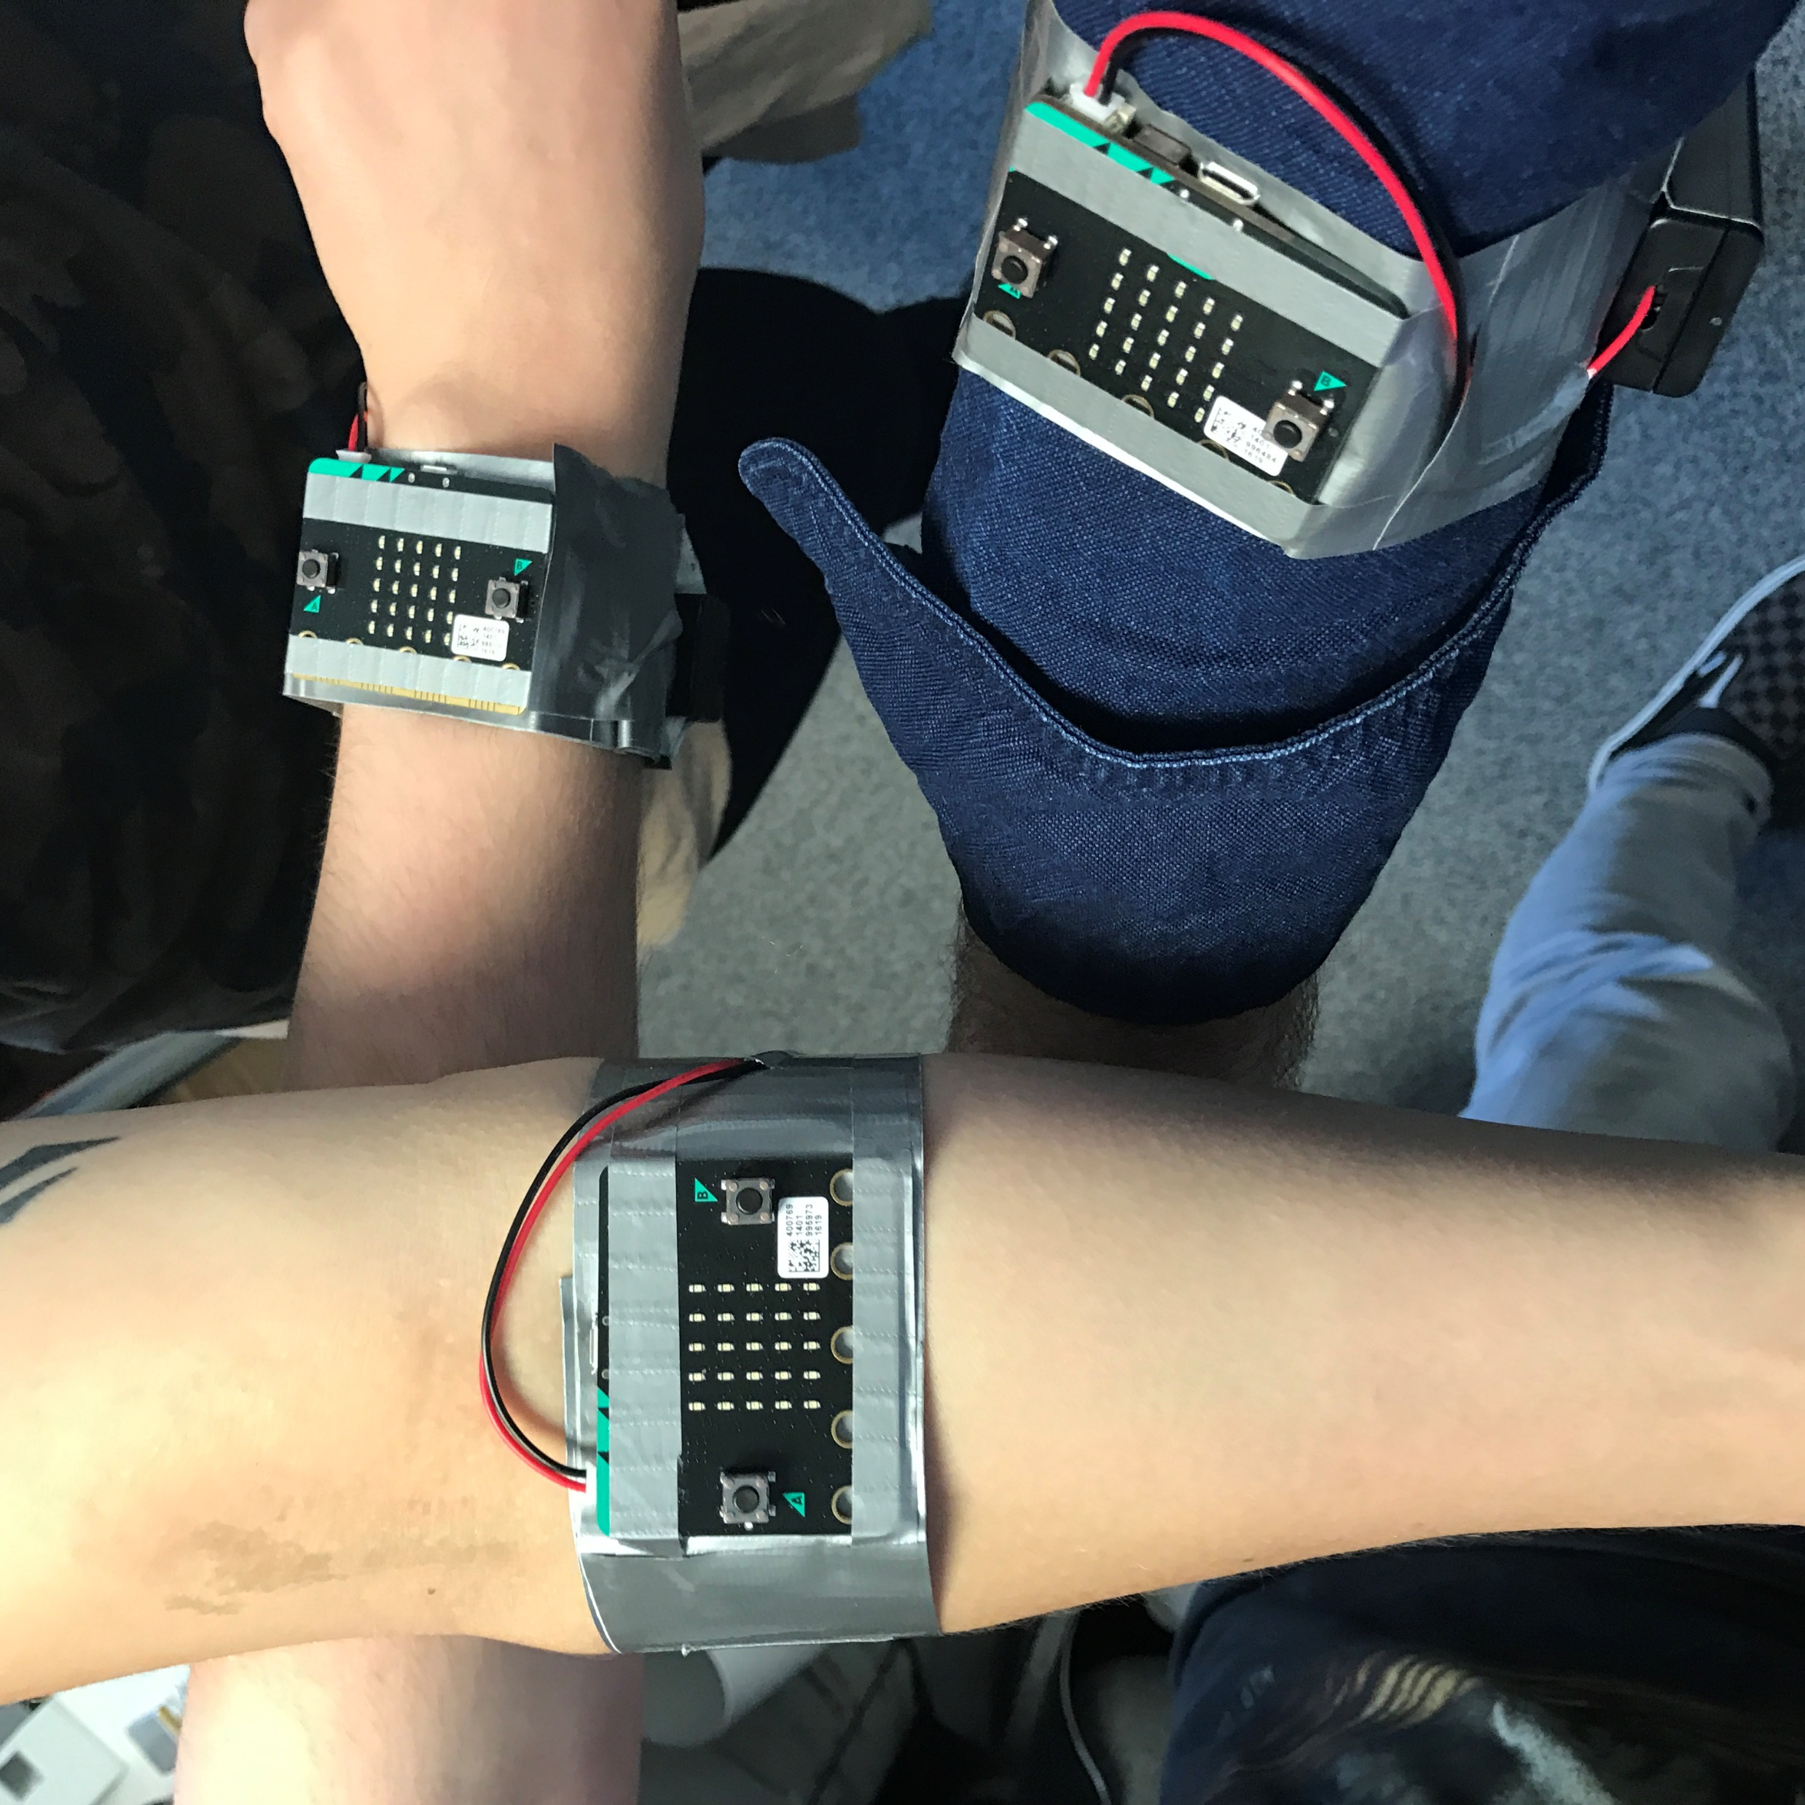
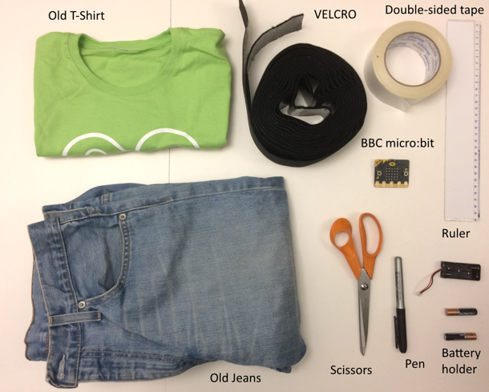
Wearables: Dance/Music/Fitness
Notes:
https://labs.redweb.com/project/controlling-music-with-movement/
https://github.com/redweblabs/microbit-tutorial
https://www.pinterest.com/pin/453808099944336819/
https://www.kitronik.co.uk/microbit.html

Slide 6
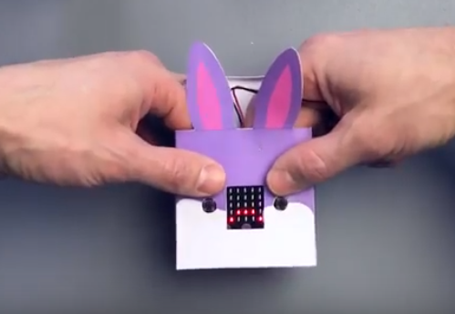
MicroPets
https://www.skillsdojo.nl/wp-content/uploads/2017/02/MicroPets-SkillsDojo-MicroBit.pdf
Notes:
https://www.skillsdojo.nl/microcomputer-uitvinden/

